Slide 1
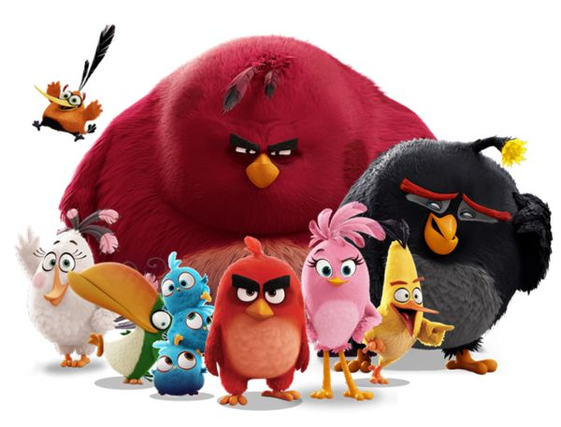
ALGORITHM
WELCOME

Slide 2
What is
a loop ?

Slide 3
A loop
A loop is type of instruction
A loop contains a list of instructions that repeat until a specified condition is reached

Slide 4
Each execution of the loop is an iteration
GO UP
GO RIGHT
GO UP
GO RIGHT
GO UP
GO RIGHT
GO UP
GO RIGHT
REPEAT 4
GO UP
GO RIGHT
=
iteration4
iteration3
iteration2
iteration1

Slide 5
A loop can contain other loops
REPEAT 3
CLAP YOUR HANDS
SAY “BANANA”
What does this program
do ?
REPEAT 2
JUMP

Slide 6
A loop can contain other loops
CLAP YOUR HANDS
SAY “BANANA”
JUMP
JUMP
CLAP YOUR HANDS
SAY “BANANA”
JUMP
JUMP
CLAP YOUR HANDS
SAY “BANANA”
JUMP
JUMP
REPEAT 3
CLAP YOUR HANDS
SAY “BANANA”
=
REPEAT 2
JUMP

Slide 7


CHALLENGE
MAX BLOC
BLOCS
#3
10
GO RIGHT
PICK UP
REPEAT< N time >
GO UP
REPEAT< 4 >
GO RIGHT
PICK UP
GO UP
REPEAT< N time >
GO RIGHT
PICK UP

Slide 8
CHALLENGE
MAX BLOC
BLOCS
#4
10
GO RIGHT
PICK UP
REPEAT< N time >
GO UP
GO RIGHT
REPEAT< 5 >
GO RIGHT
PICK UP
REPEAT< 6 >
GO RIGHT
PICK UP

Slide 9
CHALLENGE
MAX BLOC
BLOCS
#5
06
GO RIGHT
PICK UP
REPEAT< N time >
GO UP
REPEAT< 3 >
GO RIGHT
REPEAT< 3 >
GO RIGHT
PICK UP
GO RIGHT

Slide 10
CHALLENGE
MAX BLOC
BLOCS
#6
08
GO RIGHT
PICK UP
REPEAT< N time >
GO UP
GO DOWN
GO RIGHT
REPEAT< 4 >
GO DOWN
PICK UP
REPEAT< 4 >
GO UP
GO RIGHT
PICK UP

Slide 11
CHALLENGE
MAX BLOC
BLOCS
#6
10
GO RIGHT
PICK UP
REPEAT< N time >
GO UP
GO DOWN
Go right
Go right
Repeat<4 time>
Repeat<5 time>
Go up
Go right
Go right
Repeat<5 time>
Go down
Pick up

Slide 12
CHALLENGE
MAX BLOC
BLOCS
#7
10
GO RIGHT
PICK UP
REPEAT< N time >
GO UP
GO DOWN
Repeat<2 time>
Go down
Pick up
Repeat<5 time>
Go right
Pick up
Go up
Pick up

Slide 13
CHALLENGE
MAX BLOC
BLOCS
#8
10
Repeat<5 time>
Go right
Repeat<4 time>
Go down
Pick up
GO RIGHT
PICK UP
REPEAT< N time >
GO UP
DROP
REPEAT<5>
GO DOWN
GO LEFT
GO RIGHT
DROP ALL DIAMONDS TO THE GREEN CELLS
REPEAT<4>
GO DOWN
PICK UP
REPEAT<4>
GO LEFT
DROP
REPEAT<4>
GO RIGHT

Slide 14
CHALLENGE
MAX BLOC
BLOCS
#9
10
GO RIGHT
PICK UP
REPEAT< N time >
GO UP
GO DOWN
GO RIGHT
REPEAT< 3 time >
GO UP
REPEAT<2 time >
GO RIGHT
GO RIGHT
GO DOWN
PICK UP
GO UP
GO UP

Slide 15


HOMEWORK
INDIV
After class
1. Review this lesson.
2. Finish all challenges
3. Submit your work to Google Classroom

